Slide 1

CAMPUS SHIELD-ANTIRAGGING AWARNESS & REPORTING SYSTEM
ABDUL JANEEB K
MES24MCA-2001
Department of Computer Applications
MES College of Engineering, Kuttippuram
20-08-2025

Slide 2
PRODUCT OWNER Mr. HYDERALI K HEAD OF DEPARTMENT DEPARTMENT OF COMPUTER APPLICATIONS MES COLLEGE OF ENGINEERING, KUTTIPPURAM

Slide 3
TABLE OF CONTENTS
Introduction
Objective
Existing System
Proposed System
Motivation
Functionalities
Module Description
Developing Environment
Sprint Backlog
Product Backlog
User Story
Project Plans
Data Flow Diagrams
ER Diagram

Slide 4
CAMPUS SHIELD-ANTIRAGGING AWARNESS & REPORTING SYSTEM
Ragging continues to affect students’ mental and emotional well-being.
Many incidents go unreported due to fear, stigma, or lack of safe reporting channels.
Provide a safe, anonymous digital platform for students to report ragging.
Promote awareness of anti-ragging laws, student rights, and available support.
Enable quick institutional response through dedicated authority dashboards.

Slide 5
Reduce unreported ragging cases.
Anonymous complaint submission form.
Authority dashboard for managing and reviewing reports.
Anti-ragging awareness resources and student rights.
Direct access to helpline numbers and anti-ragging committee contacts.

Slide 6
OBJECTIVES
Develop a safe and anonymous platform for students to report ragging incidents.
Provide quick access to helplines and the institutional anti-ragging committee.
Equip institutions with tools to respond swiftly and effectively to complaints
Ensure secure data storage of complaints and reports using a reliable backend.
Reduce the number of unreported ragging cases through empowerment and trust.

Slide 7
EXISTING SYSTEM
Lack of dedicated digital platforms for reporting ragging incidents anonymously.
Most complaints are handled through manual processes.
No real-time tracking or monitoring of submitted complaints by authorities.
Limited access to anti-ragging policies, helplines, and legal awareness for students.
Delayed or inefficient institutional response due to fragmented communication channels.

Slide 8
PROPOSED SYSTEM
A web-based platform for anonymous and secure ragging complaint submissions.
Students can file complaints anytime, anywhere using just a smartphone or computer, without the need to physically approach authorities.
Authorities receive real-time alerts whenever a new complaint is submitted..
Secure data storage using SQLite to maintain privacy and integrity of reports.

Slide 9
MOTIVATIONS
Urgent need to educate students about their rights and available legal protections.
Increase in unreported cases, leading to prolonged suffering and inaction.
Need to eliminate stigma and fear associated with filing complaints.
Ragging severely affects academic performance, mental health, and self-esteem of victims.
Promote a standardized complaint handling process across campuses.

Slide 10
FUNCTIONALITIES
Anonymous Complaint Submission
Students can submit ragging complaints without revealing their identity.
Complaint Management Dashboard
Admin/committee members can view, track, and respond to complaints efficiently.
Helpline & Contact Information
Quick access to emergency helplines, anti-ragging committee members, and support services.

Slide 11
FUNCTIONALITIES
Awareness Content
Information about anti-ragging laws, student rights, and preventive measures.
Secure Data Storage
Complaints and records stored safely using SQLite to ensure privacy.
Institutional Alerts & Notifications
Authorities receive instant updates when a new complaint is filed.

Slide 12
MODULE DESCRIPTION
1. User Module (Students)
Submit complaints anonymously.
Access helplines and support contacts.
View awareness content and student rights.
2. Complaint Management Module (Admin/Committee)
View and manage submitted complaints.
Update status of cases (Pending, In Progress, Resolved).
Generate complaint reports for authorities.

Slide 13
MODULE DESCRIPTION
3. Awareness & Resource Module
Provide information on anti-ragging laws and punishments.
Display FAQs and preventive measures.
Share guidance materials and awareness campaigns.

Slide 14
DEVELOPING ENVIRONMENT
Operating System → Windows / Linux
Frontend → HTML, CSS, Bootstrap
Backend → Python with Django framework
Database → SQLite
Framework → Django
IDE / Code Editor → VS Code / PyCharm
Web Browser → Google Chrome / Firefox
Version Control → Git & GitHub

Slide 15
SPRINT BACKLOG
Backlog Item | Status and Completion Date | Original Estimation in Hours | Day 1 hrs | Day 2 hrs | Day 3 hrs | Day 4 hrs | Day 5 hrs | Day 6 hrs | Day 7 hrs | Day 8 hrs | Day 9 hrs | Day 10 hrs
SPRINT 1
Requirement Analysis | 10/08/2025 | 5 | 2 | 2 | 1 | 0 | 0 | 0 | 0 | 0 | 0 | 0
System Design (DFD, ER) | 12/08/2025 | 6 | 2 | 2 | 2 | 0 | 0 | 0 | 0 | 0 | 0 | 0
SPRINT 2
Frontend Development | 21/08/2025 | 10 | 2 | 2 | 2 | 2 | 2 | 0 | 0 | 0 | 0 | 0
Backend Development | 26/08/2025 | 15 | 2 | 2 | 2 | 3 | 3 | 3 | 0 | 0 | 0 | 0

Slide 16
SPRINT BACKLOG
SPRINT 3
Database Setup | 06/09/2025 | 5 | 2 | 2 | 1 | 0 | 0 | 0 | 0 | 0 | 0 | 0
Integration & Testing | 12/09/2025 | 12 | 2 | 2 | 2 | 2 | 2 | 2 | 0 | 0 | 0 | 0
Deployment & Documentation | 18/09/2025 | 8 | 2 | 2 | 2 | 2 | 0 | 0 | 0 | 0 | 0 | 0
SPRINT 4
Security & Authentication | 21/09/2025 | 10 | 2 | 2 | 2 | 2 | 2 | 0 | 0 | 0 | 0 | 0
Reports & Deployment | 29/09/2025 | 12 | 2 | 2 | 2 | 2 | 2 | 2 | 0 | 0 | 0 | 0
TOTAL |  | 70

Slide 17
PRODUCT BACKLOG
ID | NAME | PRIORITY | ESTIMATE (Hours) | STATUS (Planned / In progress / Completed)
1 | User Registration (Anonymous & Secure) | High | 6 | In Progress
2 | Login & Admin Authentication | High | 6 | In Progress
3 | Complaint Submission Form | High | 12 | Planned
4 | Database Setup & Integration | High | 10 | Planned
5 | Admin Dashboard (View & Manage Cases) | High | 15 | Planned
6 | Awareness Content (Laws & Rights) | Medium | 8 | Planned
7 | Helpline & Anti-Ragging Contacts | High | 7 | Planned

Slide 18
PRODUCT BACKLOG
8 | Notifications (Email/SMS Alerts) | Medium | 12 | Planned
9 | Testing, Debugging & Deployment | High | 15 | Planned

Slide 19
USER STORY
User Story ID | As a type of User | I want to | So that I can
1 | STUDENT | Submit Complaint | Report ragging anonymously without fear
2 | STUDENT | Access Helplines & Contacts | Get immediate support from anti-ragging committee
3 | STUDENT | View Awareness Content | Learn about anti-ragging laws, rights & preventive measures
4 | ADMIN / COMMITTEE | View Complaints | Monitor and respond to reported incidents
5 | ADMIN / COMMITTEE | Update Complaint Status | Track cases as Pending, In Progress, or Resolved
6 | ADMIN / COMMITTEE | Generate Reports | Maintain institutional records for compliance
7 | INSTITUTION | Receive Alerts & Notifications | Take timely action and ensure campus safety

Slide 20
PROJECT PLAN
User Story ID | Task Name | Start Date | End Date | Days | Status
1 | SPRINT 1 | 10/08/2025 | 12/08/2025 | 9 | Completed
2 |  | 13/08/2025 | 17/08/2025 |  | Completed
3 | SPRINT 2 | 20/08/2025 | 25/08/2025 | 17 | Planned
4 |  | 26/08/2025 | 05/09/2025 |  | Planned
5 | SPRINT 3 | 06/09/2025 | 10/09/2025 | 14 | Planned
6 |  | 11/09/2025 | 17/09/2025 |  | Planned
7 |  | 18/09/2025 | 20/09/2025 |  | Planned

Slide 21
PROJECT PLAN
User Story ID | Task Name | Start Date | End Date | Days | Status
8 | SPRINT 4 | 21/09/2025 | 25/09/2025 | 15 | Planned
9 |  | 26/09/2025 | 05/10/2025 |  | Planned

Slide 22
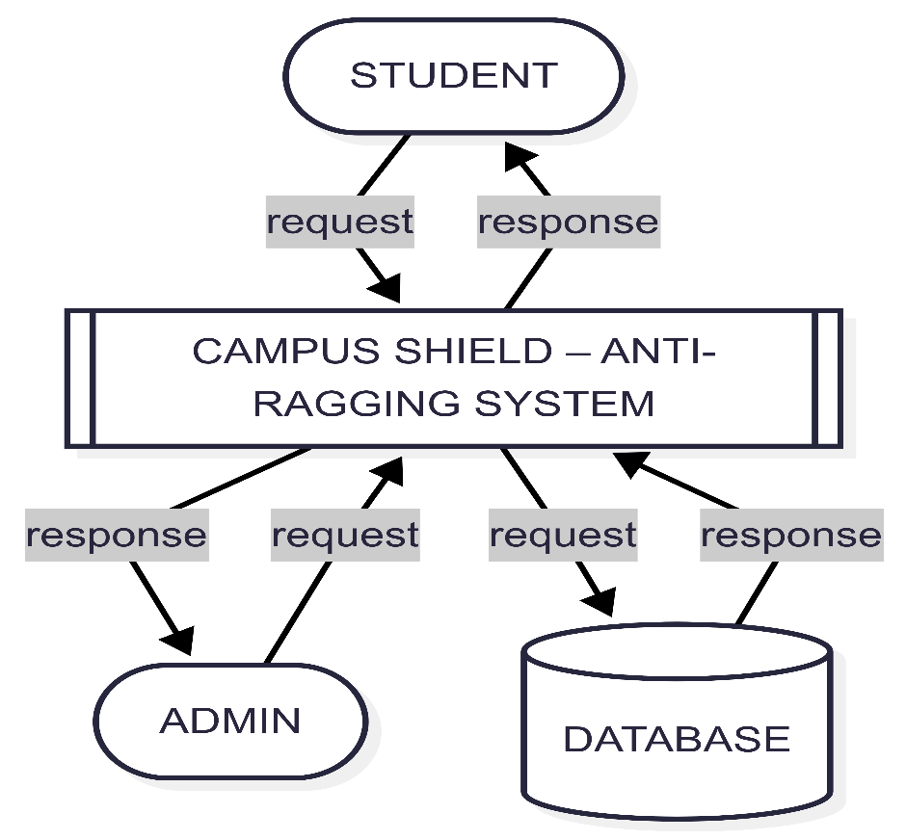
DATA FLOW DIAGRAM
LEVEL 0

Slide 23
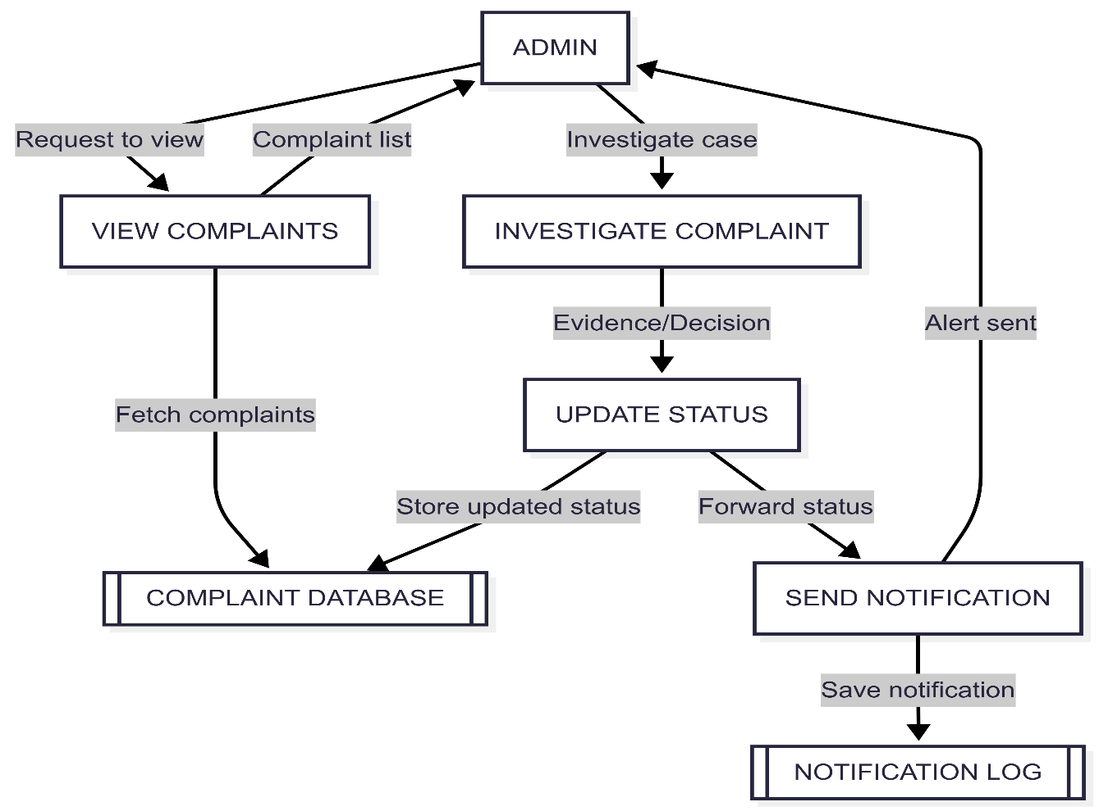
DATA FLOW DIAGRAM
Level 1

Slide 24
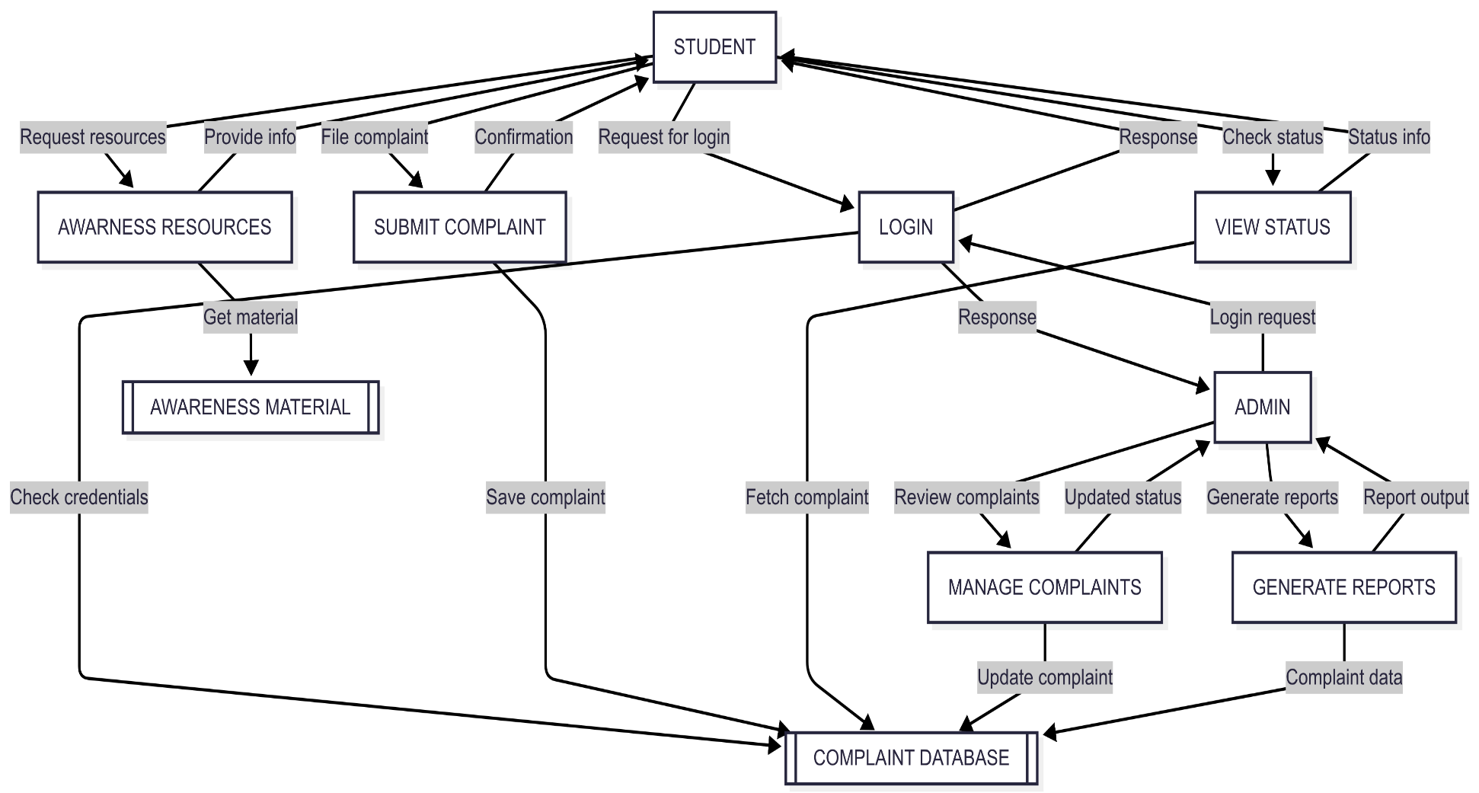
DATA FLOW DIAGRAM
Level 1.1

Slide 25
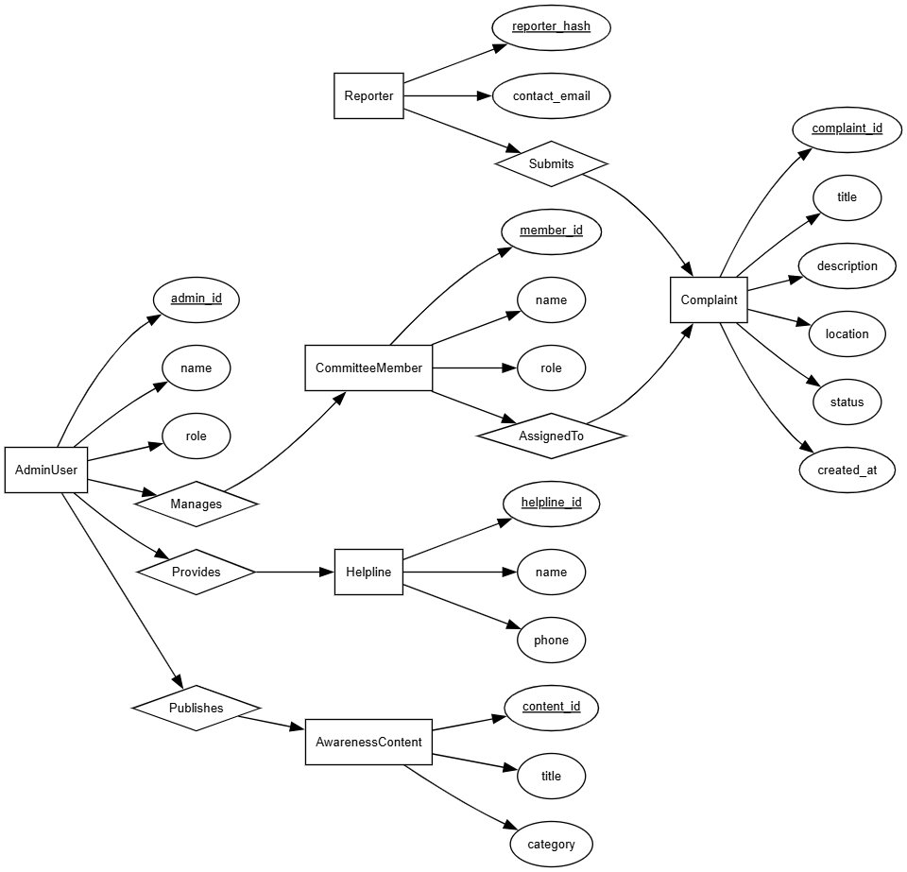
ER DIAGRAM

Slide 26
THANK YOU

